Slide 1
Regular Expression Module In Python

Slide 2
In Python, wildcards are often referred to as metacharacters in regular expressions. These metacharacters have special meanings and are used to define patterns for matching strings. Here are some commonly used wildcards (metacharacters) in Python's re module along with examples:

Slide 3
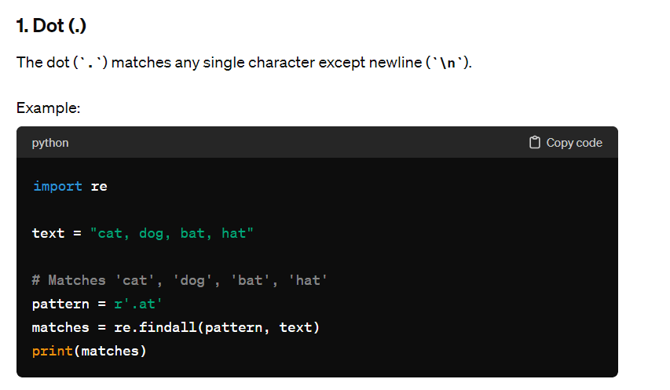

Slide 4
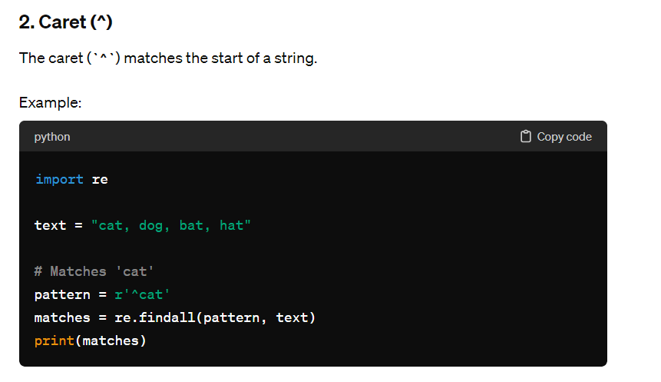

Slide 5
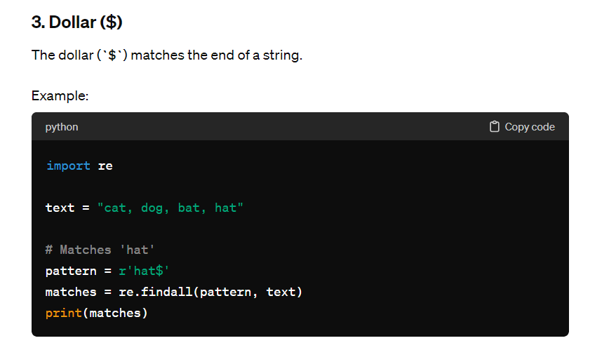

Slide 6
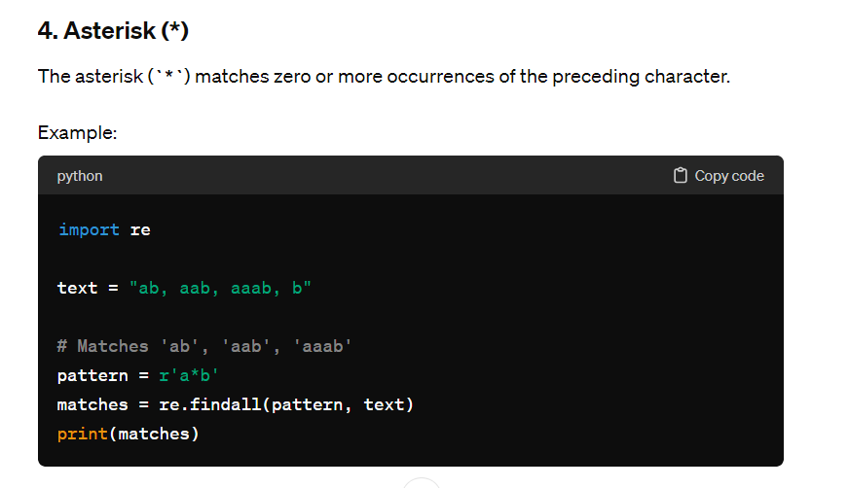

Slide 7
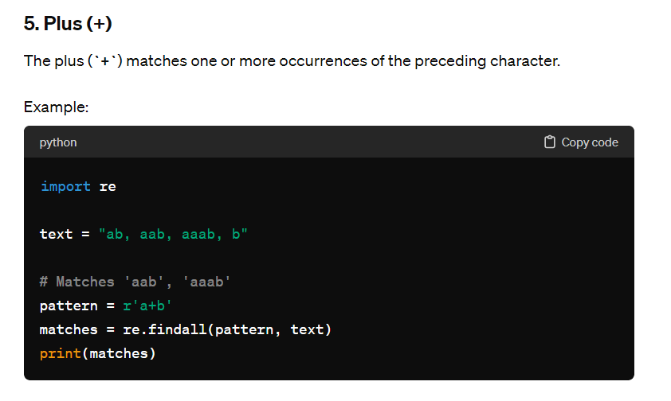

Slide 8
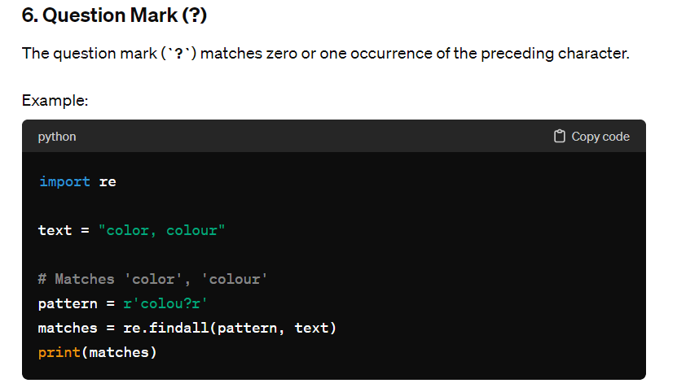

Slide 9
The re module in Python provides support for working with regular expressions. Regular expressions are powerful tools for pattern matching and string manipulation. The re module allows you to perform various operations such as searching for patterns, replacing text, and splitting strings based on patterns. Let's explore the re module in detail with examples:

Slide 10
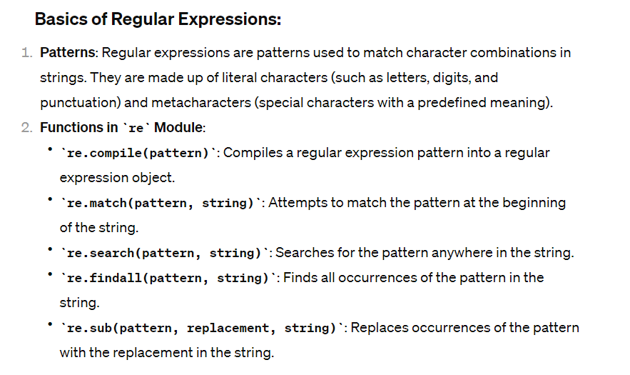

Slide 11
1. Matching Patterns:
import re
pattern = r'apple'
text = 'An apple a day keeps the doctor away'
# Check if pattern matches at the beginning of the string
match_result = re.match(pattern, text)
print("Match result:", match_result)
# Search for pattern anywhere in the string
search_result = re.search(pattern, text)
print("Search result:", search_result)
# Find all occurrences of the pattern
findall_result = re.findall(pattern, text)
print("Findall result:", findall_result)

Slide 12
2. Replacing Patterns:
import re
pattern = r'\d+'
replacement = 'X'
text = 'Today is 2022-01-15'
# Replace all digits with 'X'
new_text = re.sub(pattern, replacement, text)
print("Replaced text:", new_text)

Slide 13
3. Splitting Strings based on Patterns:
import re
pattern = r'\s+' # Split on one or more whitespace characters
text = 'Python programming is fun'
# Split the string based on pattern
split_result = re.split(pattern, text)
print("Split result:", split_result)

Slide 14
4. Using Groups:
import re
pattern = r'(\w+), (\w+)'
text = 'Doe, John'
# Extract first and last name using groups
match_result = re.match(pattern, text)
if match_result:
last_name = match_result.group(1)
first_name = match_result.group(2)
print("Last name:", last_name)
print("First name:", first_name)

Slide 15
In the regular expression pattern r'(\w+), (\w+)', the \w+ is a pattern that matches one or more alphanumeric characters (letters, digits, or underscores). Here's what it means:
\w: This metacharacter matches any alphanumeric character and underscores.
+: This quantifier specifies that the preceding pattern (in this case, \w) should match one or more times, effectively matching sequences of alphanumeric characters.
So, \w+ in the regular expression pattern matches one or more alphanumeric characters in a string. In the context of the provided code example, (\w+) is used twice to capture two groups of alphanumeric characters separated by a comma and space (, ) in the input text.
For example, given the input text 'Doe, John', the regular expression pattern (\w+), (\w+) would match and capture the following groups:
Group 1: Doe (matches one or more alphanumeric characters before the comma)
Group 2: John (matches one or more alphanumeric characters after the comma and space)
These captured groups can then be accessed using the group() method of the match object returned by re.match() or re.search(), as shown in the code example provided.

Slide 16
Let's create a simple pattern in Python using the re module to match email addresses in a given text. Email addresses typically follow a pattern of username@domain.extension.
Here's how you can create a pattern to match email addresses:
import re
# Sample text containing email addresses
text = "Contact us at info@example.com or support@example.org for assistance."
# Regular expression pattern to match email addresses
email_pattern = r'\b[A-Za-z0-9._%+-]+@[A-Za-z0-9.-]+\.[A-Z|a-z]{2,}\b'
# Find all email addresses in the text
matched_emails = re.findall(email_pattern, text)
# Print the matched email addresses
print("Matched email addresses:", matched_emails)

Slide 17
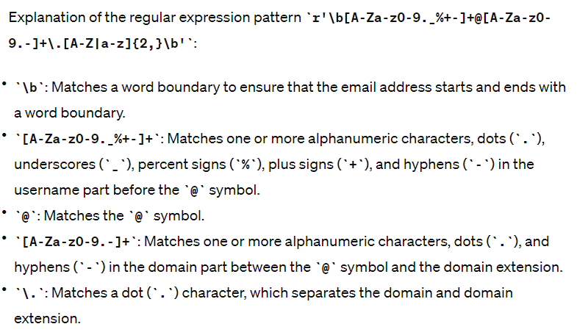

Slide 18
